Slide 1
PROGRAMMING
FOR
PROBLEM
SOLVING
(PPS)
​

Slide 2

NAME OF THE
FACULTY:
PRASHANT SIR
Presented by:
226Y1A66B7
226Y1A66B8
226Y1A66B9

Slide 3
Topic parity game

Slide 4
Mancunian is playing the famous parity game . In this game , the player is given an array A Comprising of n positive integers. The goal is to remove some (possibly Empty) subsequence of these integers so that the sum of the resulting array is even . The player is NOT allowed to remove all the numbers (i.e .,the resulting array should be nonempty).

Slide 5
There can be multiple possible Subsequences that can be removed to achieve this . Print the size of the smallest such Subsequences. If there is no such Subsequences,print-1.

Slide 6
.
Input format:
The first line of input contains the size of the array , n .The second line contains n space-separated integers,
The I th of which contains A i .
CONSTRAINTS
1 ≤ n ≤ 10
1 ≤ A

Slide 7
.
Output Format:
Print a single integer which is the answer to the given problem.
SAMPLE INPUT 0 :
5
1 2 3 4 5
SAMPLE OUTPUT 0:
1

Slide 8
Explanation 0 :
The array is (1,2,3,4,5) Sum of the possible subsequences you can remove are (1),(3),(5),(1,2),(3,4),(1,4) and (1,3,5) among others. For example , if we remove the subsequences (1,4) from (1 ,2,3,4 ,5), we get (2,3,5) which has an even sum.The smallest size among these is 1, hence we print 1.

Slide 9
SAMPLE INPUT 1:
4
1 2 3 4
SAMPLE OUTPUT 1:
0
EXPLANATION 1:
The player doesn’t need to Remove any integer.

Slide 10
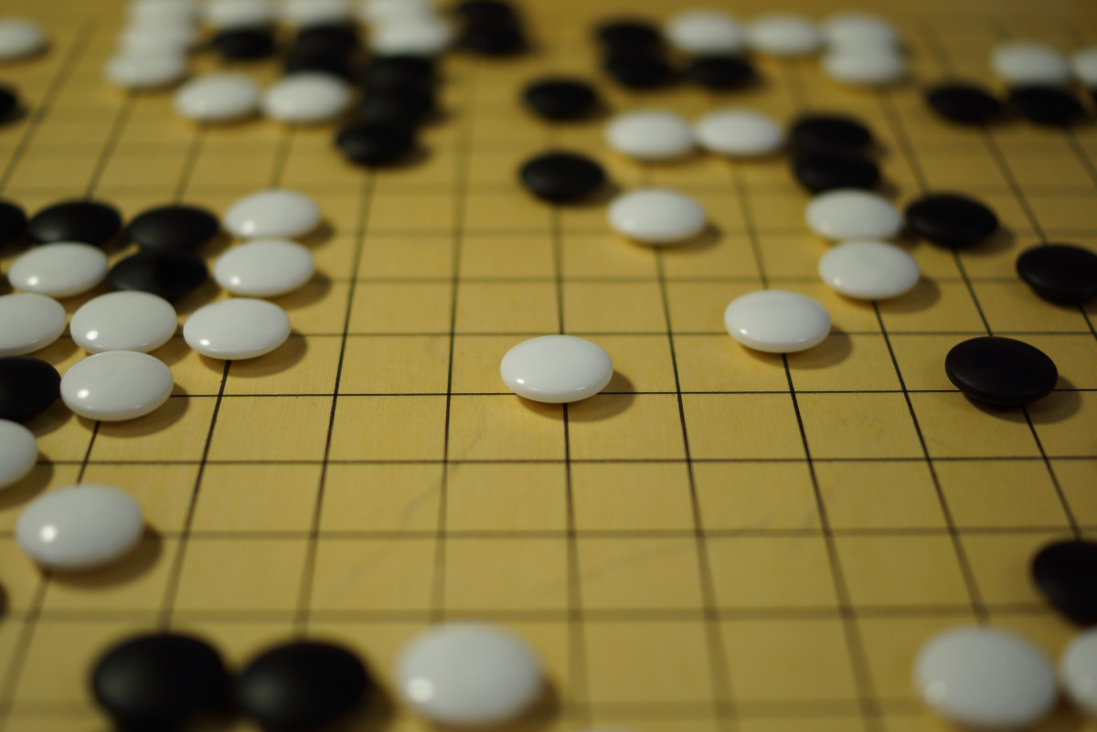
THANKING
YOU

